Slide 1
WELCOME HOME
Connect with those who matter.

Slide 2
HOME OVERVIEW
Lesson 1
Lesson 2
Lesson 3
Lesson 4
Lesson 5
Lesson 6
Home Platforms
Why Xplor Home?
Home App
Home Web
Sign in and out options
Home App - QR Code
Hub - Phone number and access code
Hub - Email and Password
Adding Bank Details
Direct Debit via Home App
Direct Debit via Home Web
Inviting Hub Guests
Authorise additional people to drop off and collect your child
Managing your child's bookings using Xplor Home App
Setting up your account

Slide 3
XPLOR HOME
1
HOME PLATFORMS

Slide 4
HOME OVERVIEW
Why Xplor Home?
Learning Journey
View your child’s learning, featuring all the beautiful photos and videos captured throughout the day. Chat with Educators about your Child’s progress and re-discover their passions. Finally, share those special moments securely with other family members.
Health and Wellbeing
Monitor your child’s health at a glance with easy analytics covering: sleep, nutrition, toileting and sun protection. Receive and keep secure records about any medication or incident reports while at care or at home.
Booking into Child Care
Quickly and easily book into extra child care sessions when you need it most. Send messages to your centre to let them know if you’re running late or will be absent.
Finance and Child Care Subsidy
Simplify your child care financials so they’re easy to manage. Quickly see how much child care subsidy you are receiving and when payments are due.
Securely Invite Others
Send secure invitations to other friends and family to to allow them access to drop off or pick up your child at the service.

Slide 5
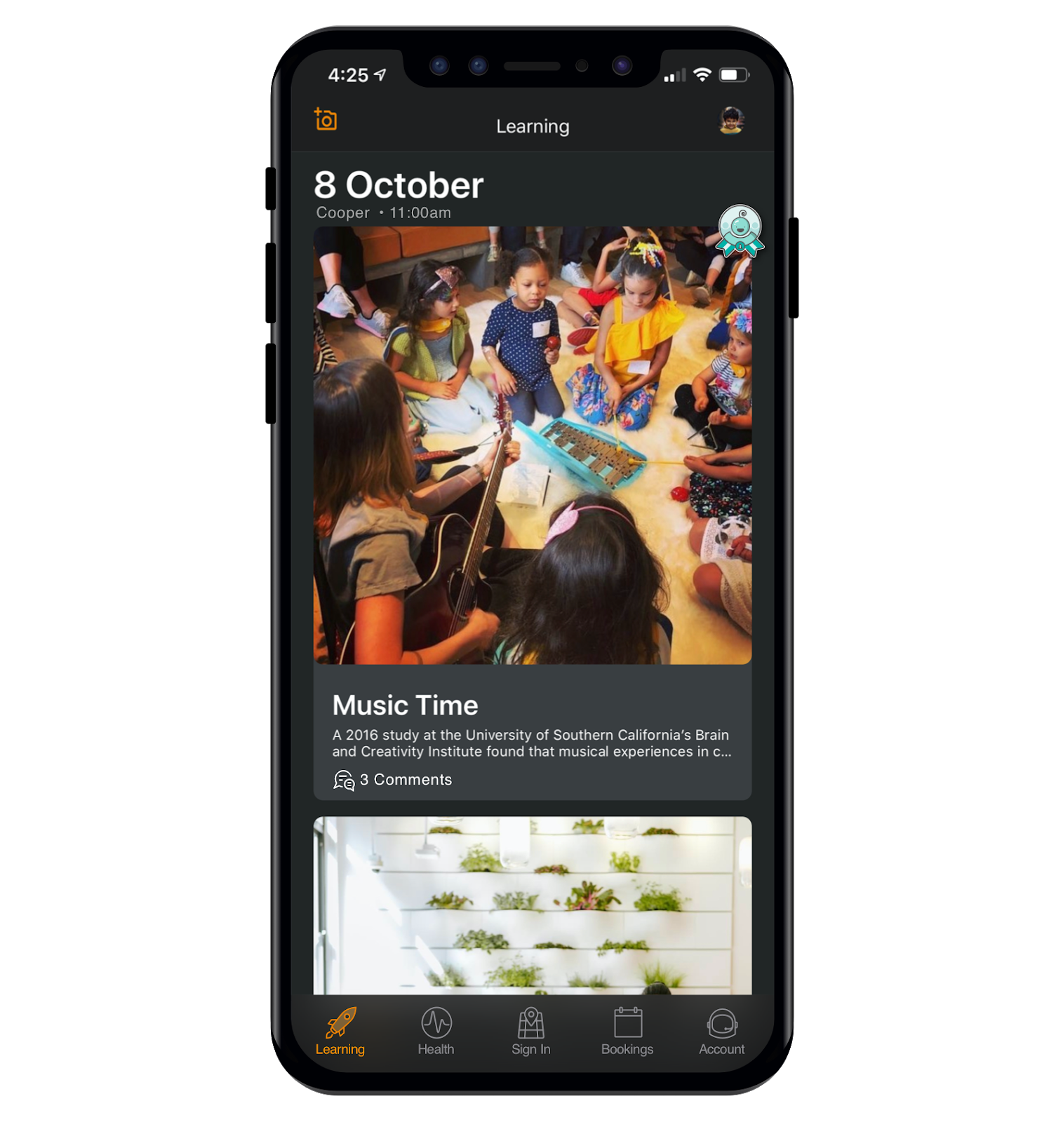
HOME APP
Learning Timeline
Health
Sign in/out
View observations from your service and record at home learning “moments”.
Receive regular updates and keep track of your child’s health at a glance.
Use the Home app to quickly sign your child in and out.
Finance
Bookings
Comms Centre
Easily manage childcare financials and subsidies.
Book your child into care quickly and easily.
View messages from your service in the Comms Centre.

Slide 6
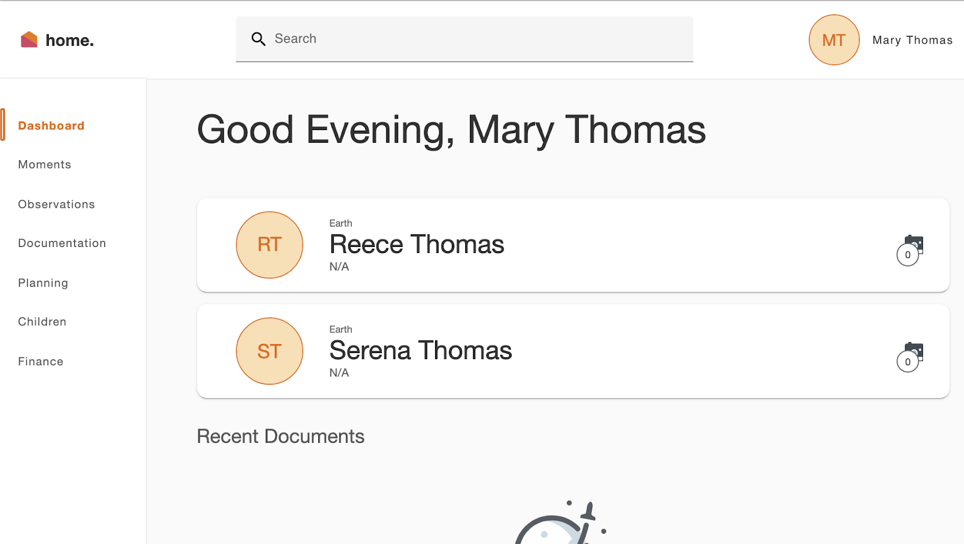
HOME WEB
View Comms Centre
View messages from your service in the Comms Centre.
View your child’s learning
View observations, documents, plans created by educators for your child
.
Access your CWA
Sign your CWA as your first step to complete your CCS enrolment
Finances
Save your payment details and view your statements at any time
Access Home Web by opening a browser and entering: home.myxplor.com

Slide 7
XPLOR HOME
2
SETTING UP YOUR ACCOUNT
Set up your Xplor Home Account!

Slide 8
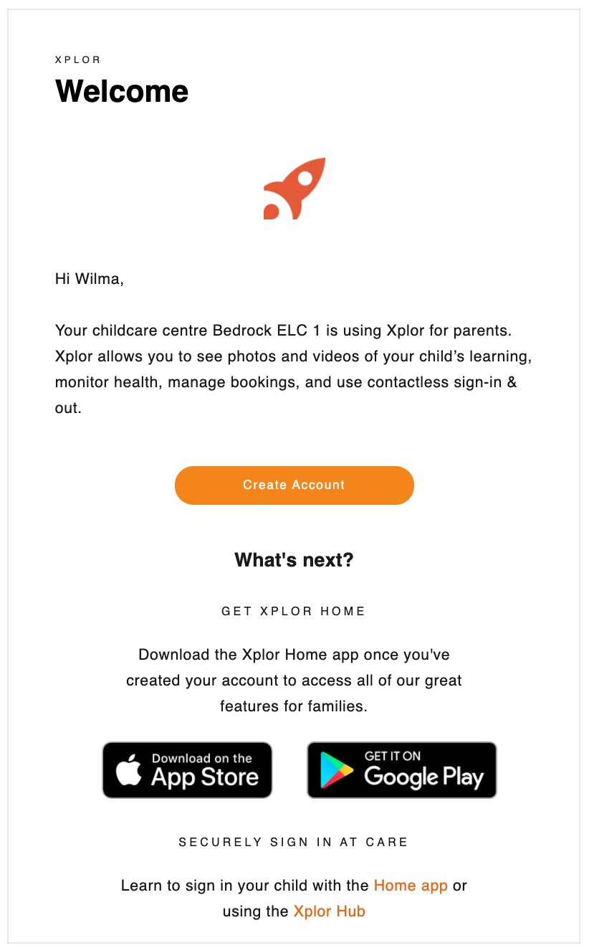
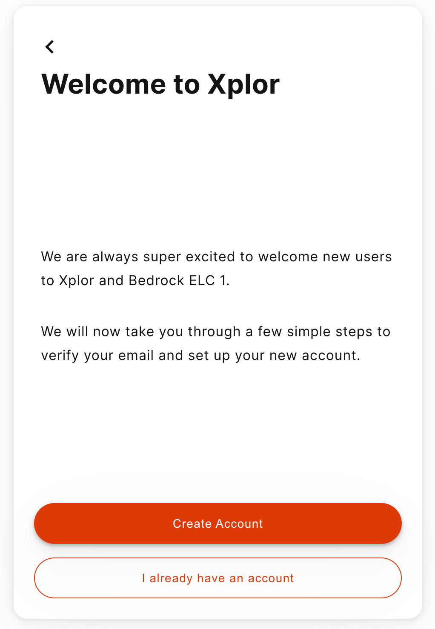
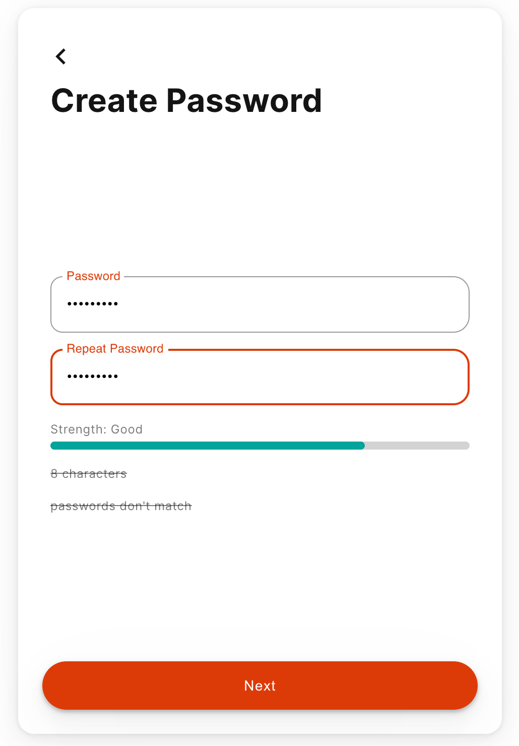
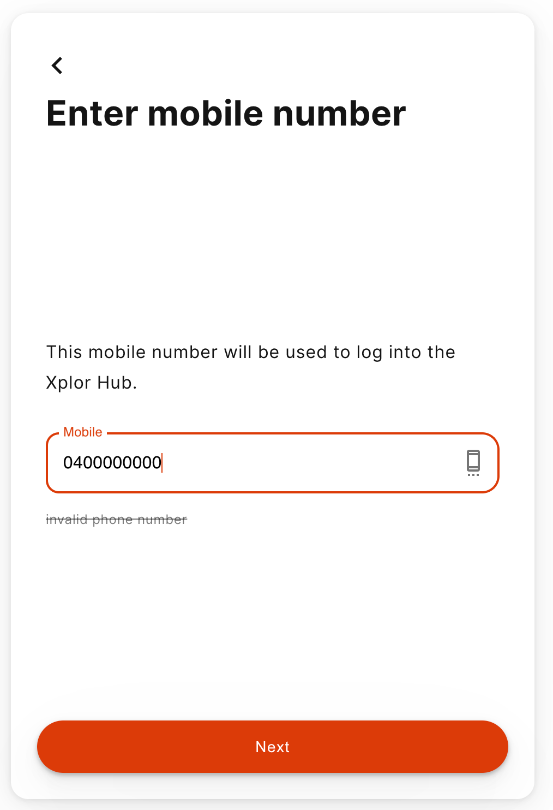
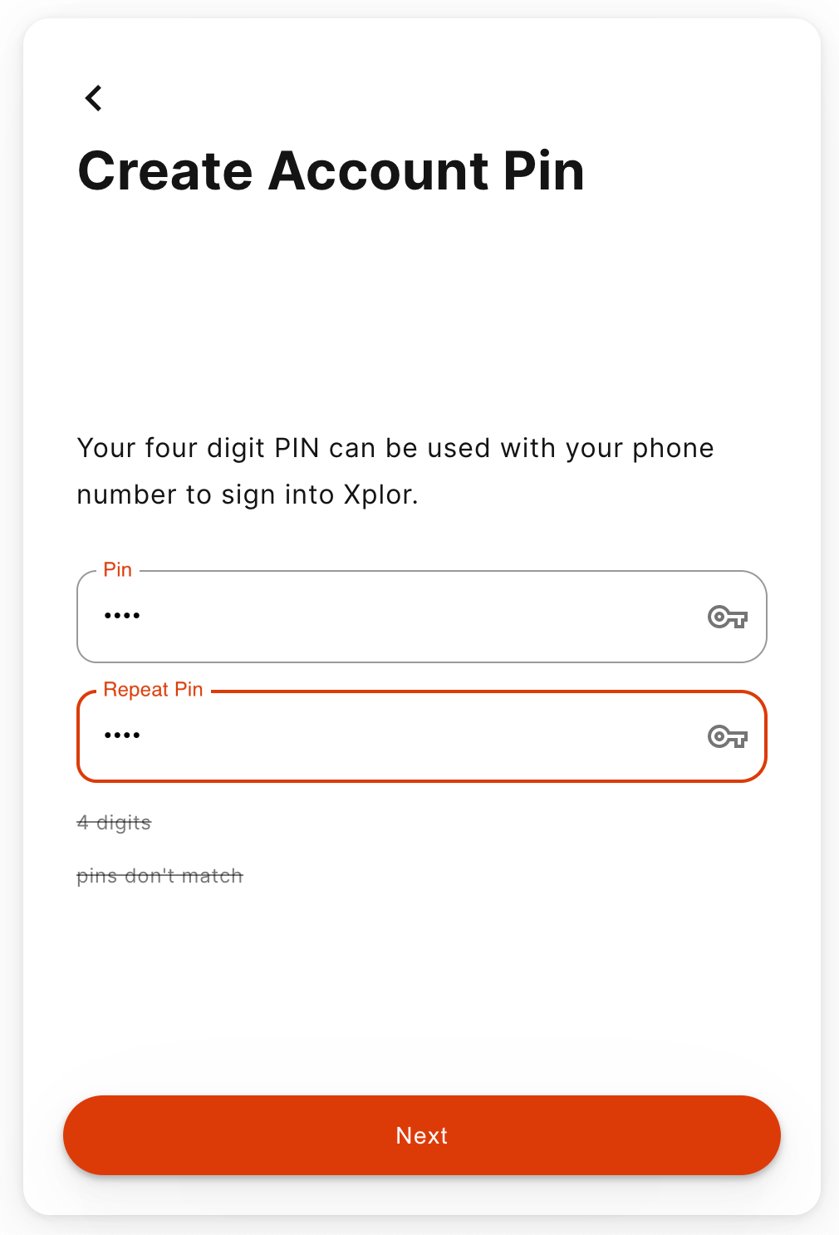
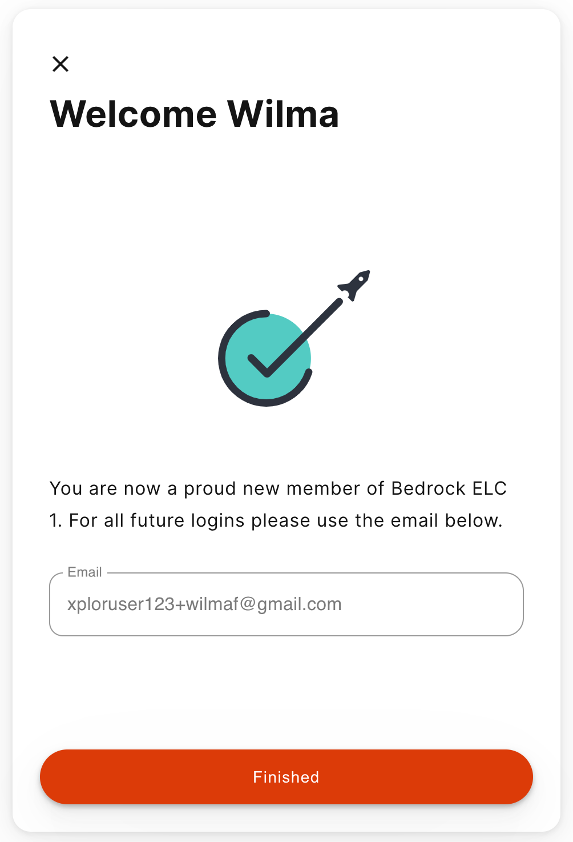
1
2
3
Setting up your Xplor Account for the first time
1
Check for an invitation email in your Inbox and select Create Account.
Click Create Account.
Tap Password.
Enter Mobile Number.
Enter Account Pin.
All Done!
2
3
4
5
6
4
5
6

Slide 9
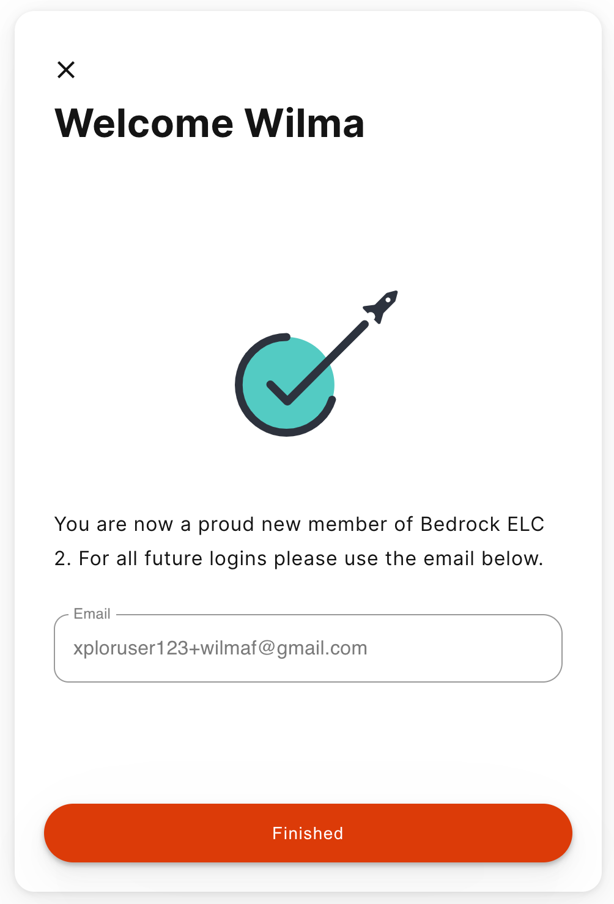
Already have an Xplor account?
1
2
1
Check for an invitation email in your Inbox and select Create Account.
All Done!
The system will automatically detect if your email address is currently registered with Xplor and will automatically merge your accounts together!
2

Slide 10
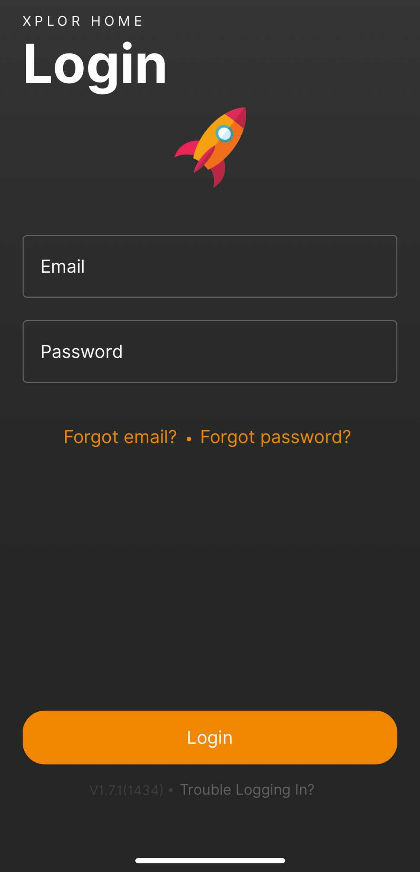
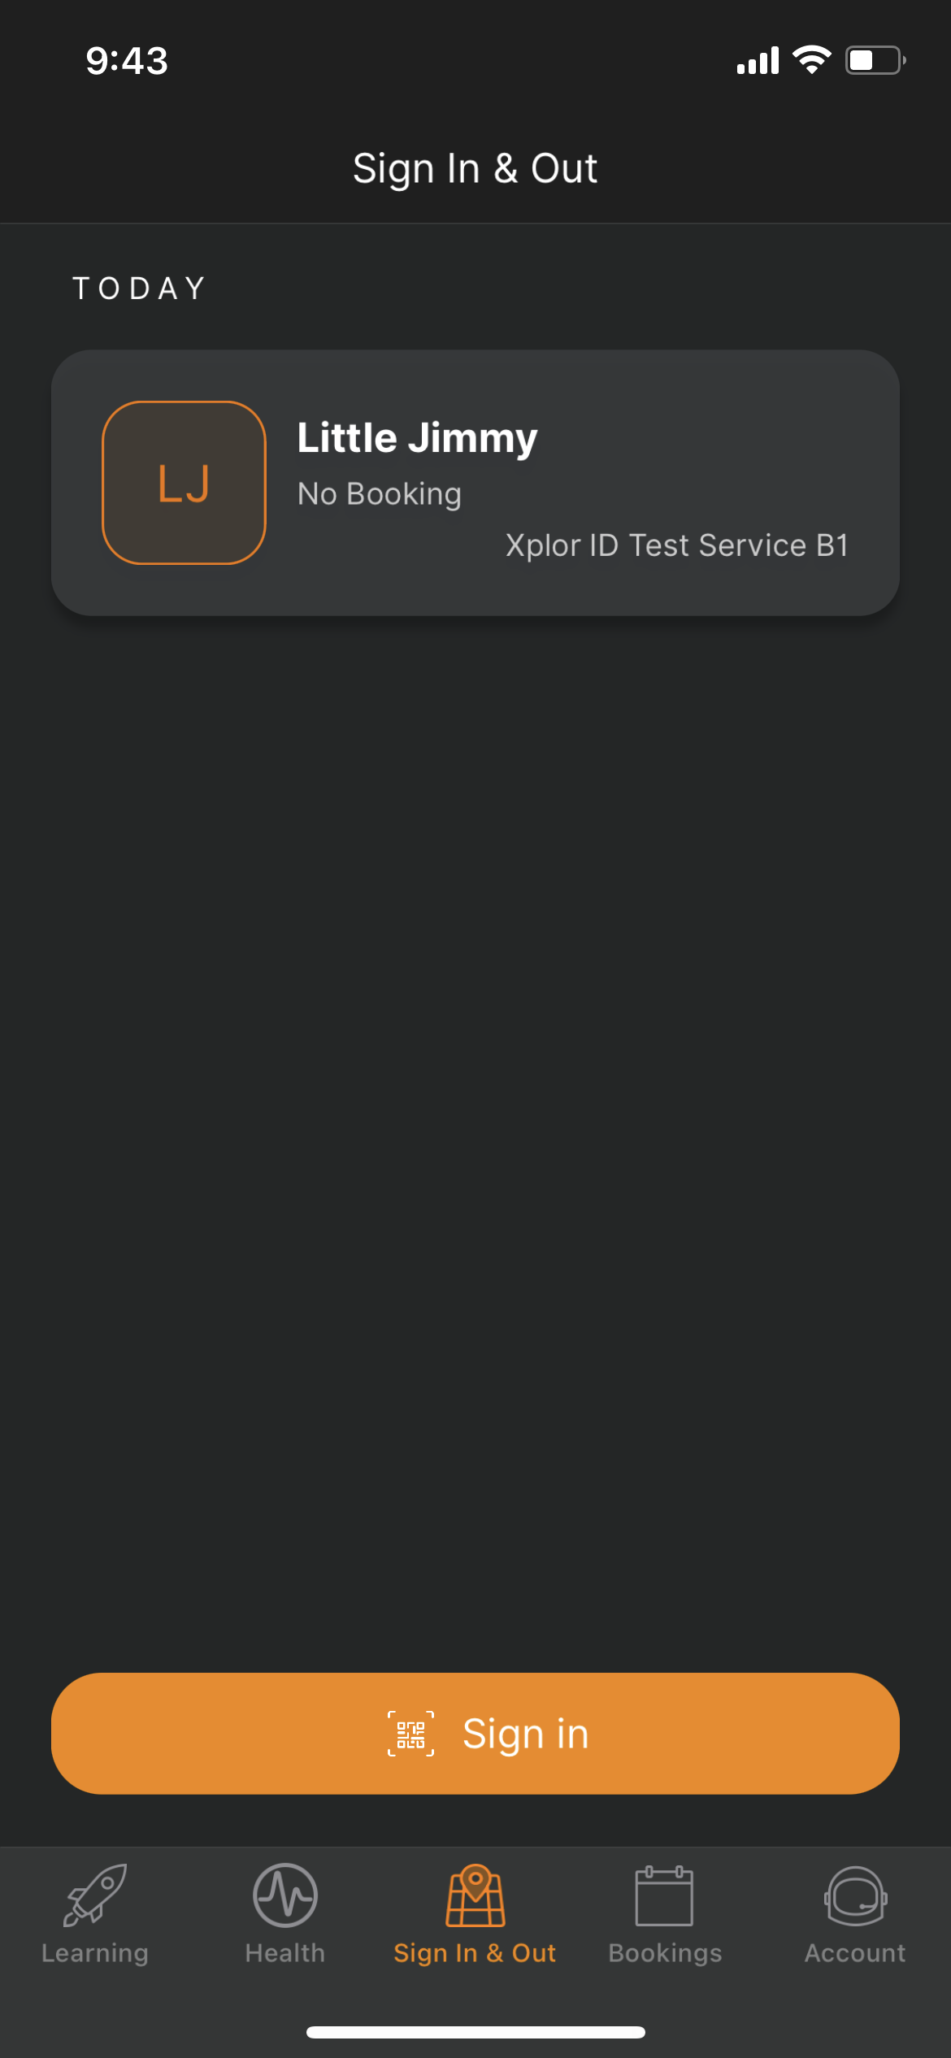
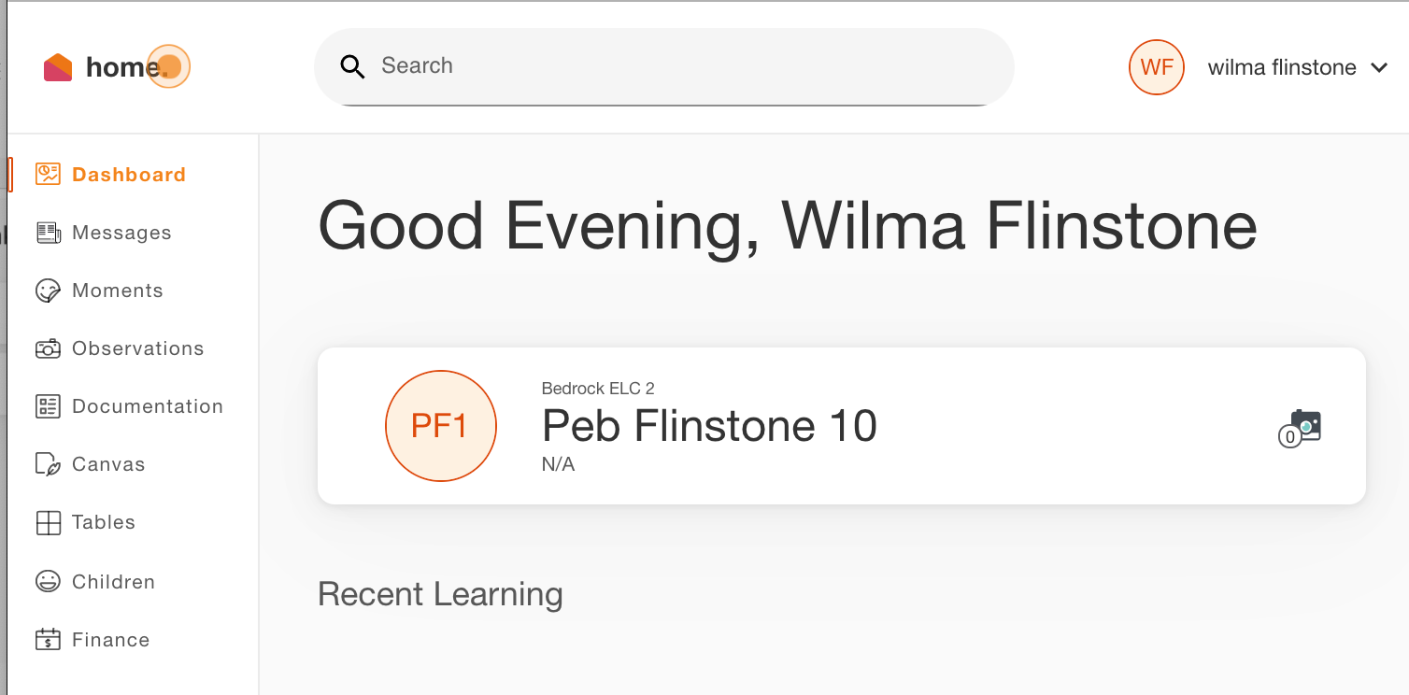
LOGGING IN
Now that you have set up your account with Xplor and your service, you are now ready to log in to either the Home App and Home Web!
1
Download the Home App via the Google Play Store or Apple Store.
Login using your Email & Password.
All Done!
You can also log in any time on the Parent Home Web platform by going to home.myxplor.com.
2
3
4

Slide 11
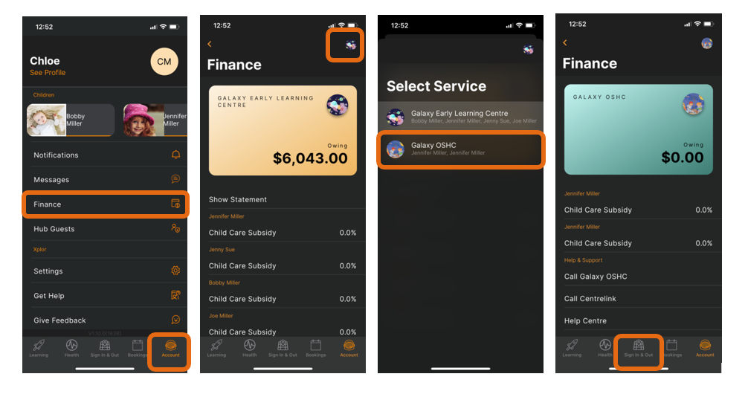
How to Toggle between centres through the Home App
1
Open the Xplor Home App
Tap on the Account Menu
Click on Finance
Click on the Centre logo
Select the new centre from the list
Click on Sign In & Out to return to the sign in/out screen
2
3
4
5
6

Slide 12
XPLOR HOME
3
SIGNING YOUR CHILD IN OR OUT
With Xplor there are 3 different ways you can sign your child in and out of care.

Slide 13
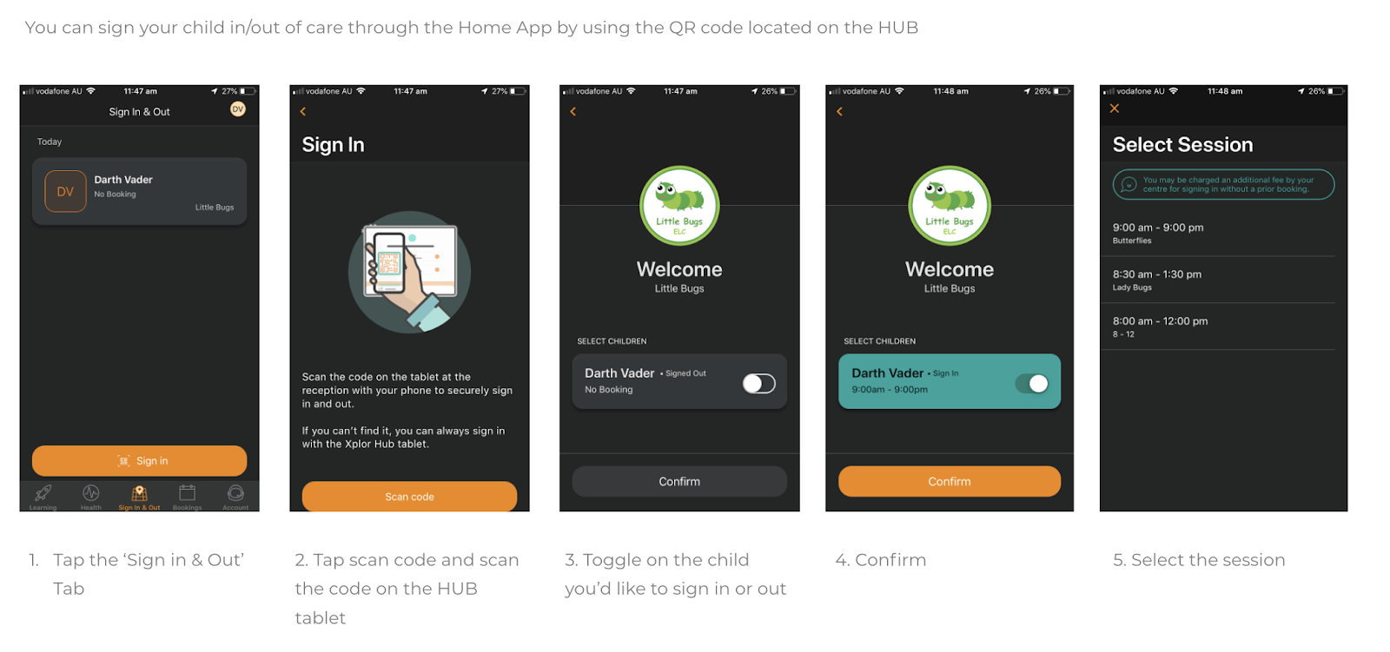
Option 1: QR CODE
1
2
3
4
5

Slide 14
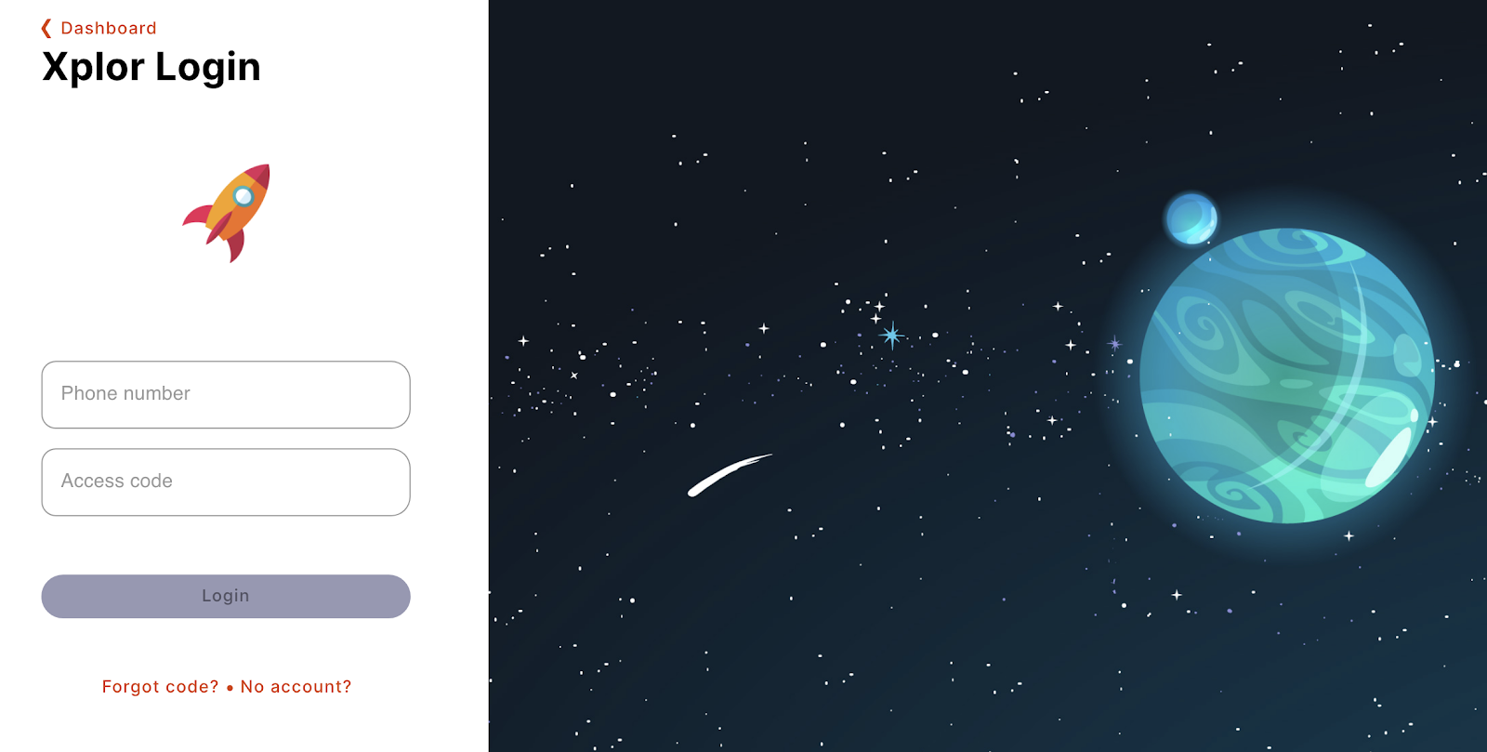
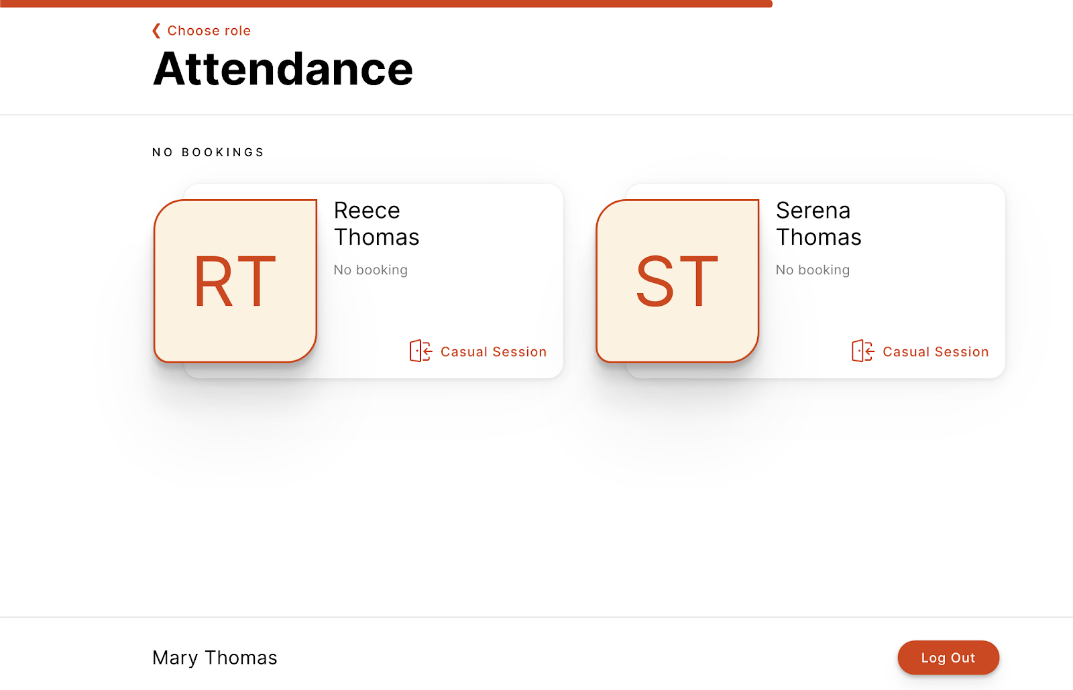
OPTION 2: Mobile Number and PIN
1
3
Tap Sign In
Enter Mobile Number and PIN
2
Tap your child’s name to sign in or out!

Slide 15
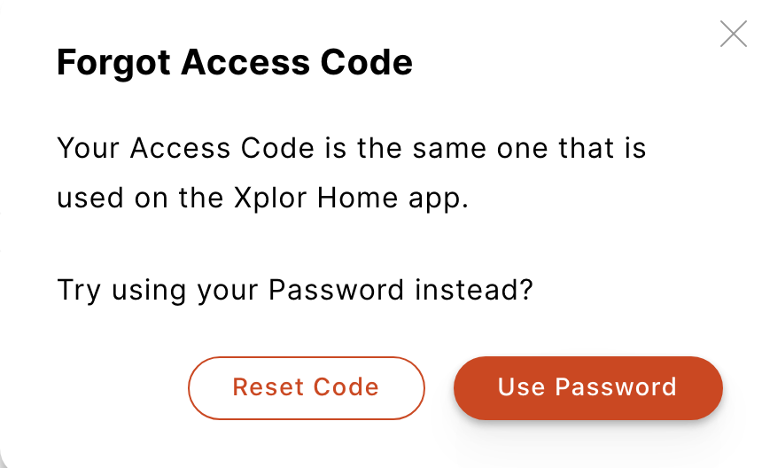
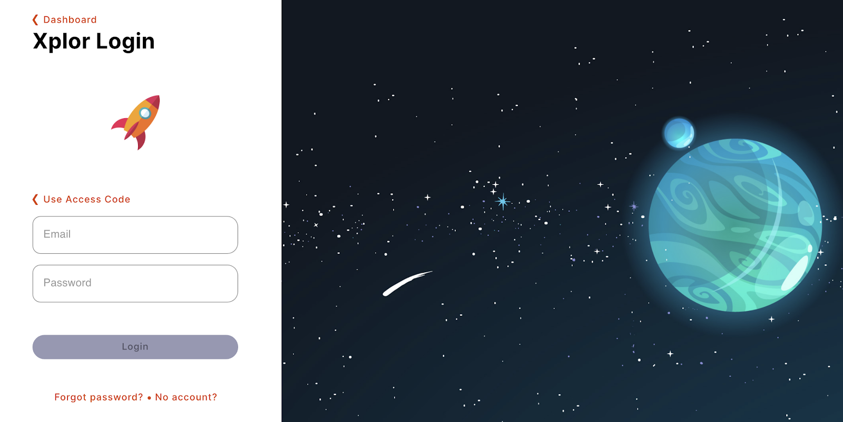
OPTION 3: Email and Password
1
Tap Sign In
2
Tap Forgot Code?
3
Tap Use Password
4
Enter Email and Password
4
Tap your child’s name to sign in or out!

Slide 16
XPLOR HOME
4
CHECKING PAYMENT DETAILS
Saving Direct Debit details via Home App
Saving Direct Debit details via Home Web
Please note: only the primary carer of the child will be able to save payment details.

Slide 17
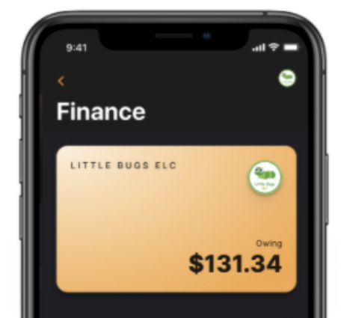
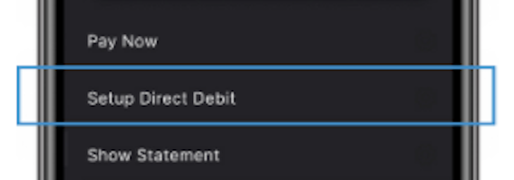
HOME APP
Adding/checking your payment details via Home App
1
In the Home App, navigate to Settings > Finance.
2
Click “Setup Direct Debit” and follow the prompts

Slide 18
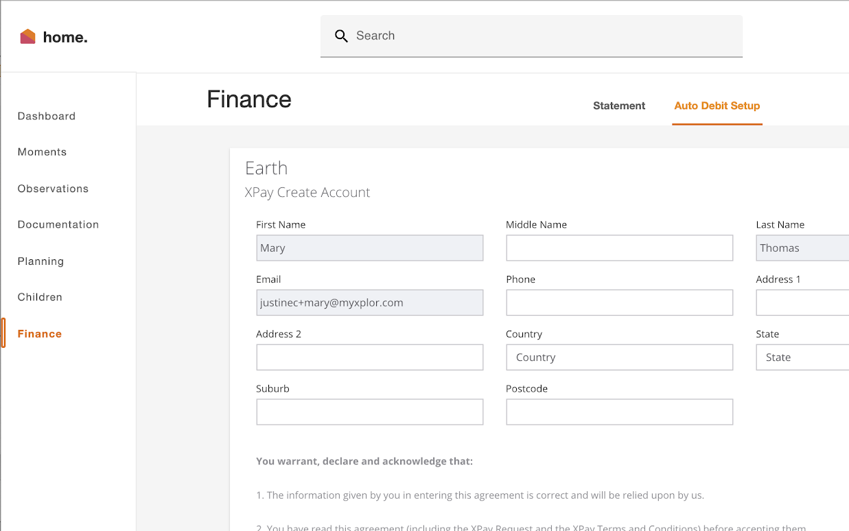
HOME WEB
Adding/checking your payment details via Home Web
1
Login to home.myxplor.com then click “Finance”
2
Click “Auto Debit Setup” and follow the prompts

Slide 19
XPLOR HOME
5
INVITING HUB GUESTS
Invite family and/or friends to pick up and drop off your child

Slide 20
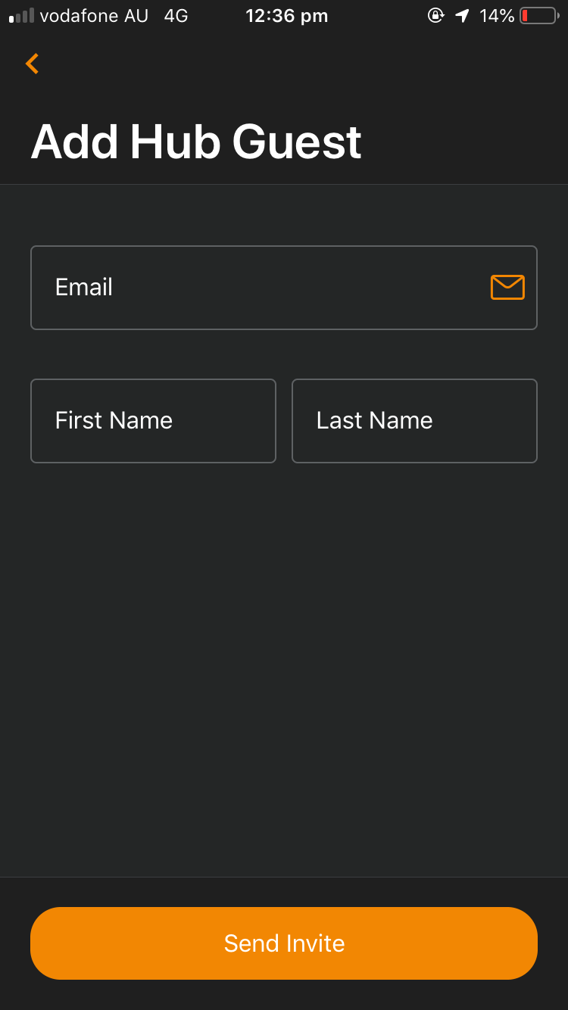
Invite family and/or friends to pick up and drop off your child
How to invite a Hub Guest via the Home App
1. Open up the Home App.
2. Click “Account”.
3. Click the “Hub Guests” menu item.
4. Click the ‘+’ icon in the top right corner of the page.
5. Enter Hub Guest name and email and click “Send Invite”.
Hub Guest Steps
1. Hub Guest will receive an email to create password once you have sent an invite..
2. Hub Guest to follow the prompts from the email.
Hub Guest sign in options
Hub Guests can sign your child in using the two options below.
Option 1: Use Mobile Number and PIN
Option 2: Email and password
Note: Hub Guests do not have access to the Home App.

Slide 21
XPLOR HOME
6
MANAGING YOUR CHILD’S BOOKINGS
View and manage your child’s future bookings using Xplor Home App

Slide 22
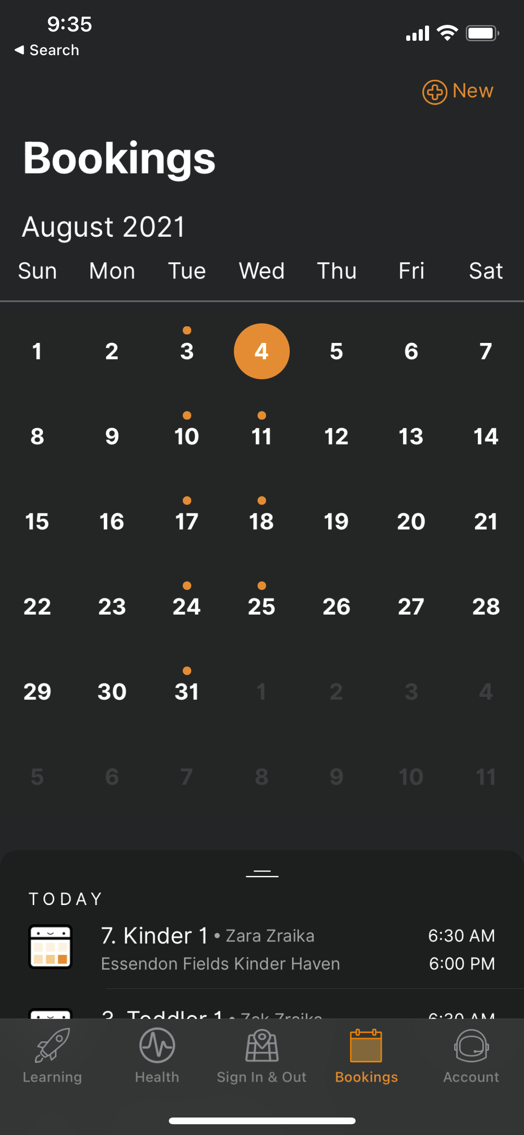
3
Managing your child’s bookings on the Home App
1
Select the Bookings option in your Home App.
Any future bookings will be indicated by an orange circle in the calendar. You can tap on those dates to view more details about the booking.
Tap the + New icon on the top right corner to request for additional bookings/absences.
You will receive a push notification once the service admin has rejected/accepted the booking request.
Note: You may not see future bookings until after your services Go Live date.
2
2
3
1

Slide 23
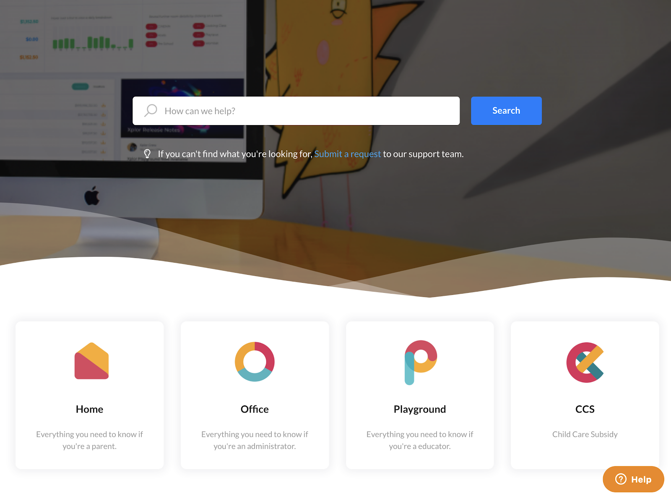
XPLOR SUPPORT
For more resources,
Visit our online knowledge base support.ourxplor.com

Slide 24
THANK YOU

